Slide 1
Footballers Classification
Project 1
Student: Nguyen Viet Minh – 20214917 Teacher: Nguyen Huu Duc

Slide 2
Content
Introduction
Dataset Description
Data Preprocessing
Model
Experiment Result
Conclusion

Slide 3
Introduction
In real-world AI problem, detecting and recognizing people by image or video is crucial.
We build an algorithm using labeled training images and label preprocessing images combine with some best basic machine learning model SVM, RF, LR.

Slide 4
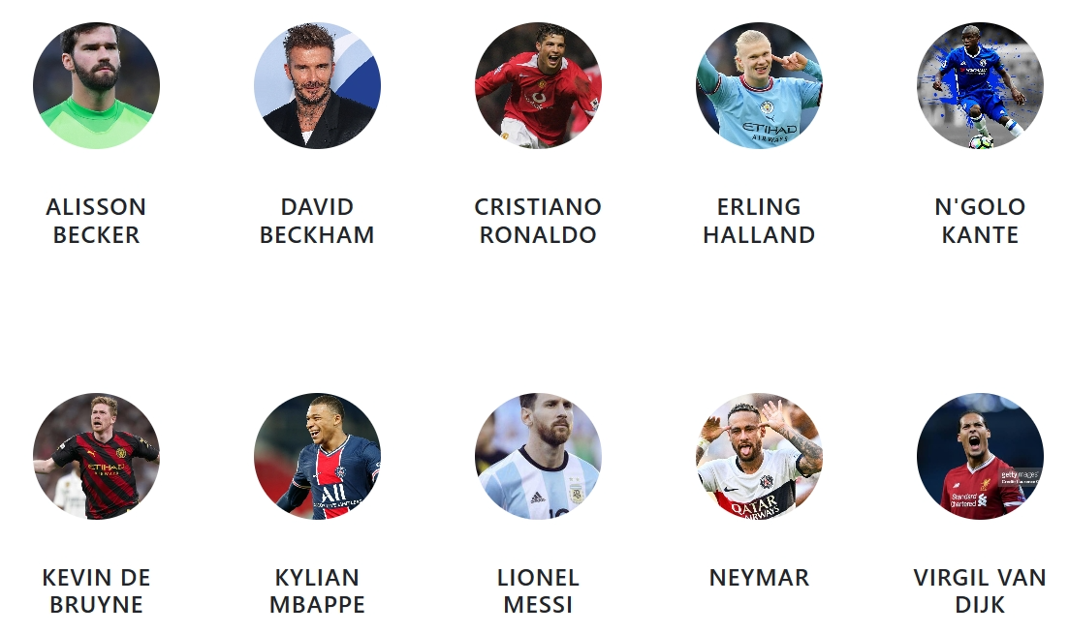
Dataset Description
Our problem is inspired from 10 famous footballers
The dataset consists of 10 famous footballers, each one have 100 images crawl from google image. So our full dataset is nearly 1000 images, because of some error image that we need to get rid of will be discuss later

Slide 5
Data Cleaning
Data Preprocessing
We use haarcascade which is one of the basic and oldest model for detection face and other part of human body. By using this model, we crop the detected face which also have 2 eyes clearly detected
Any image which can not be correctly recognized by haarcascade is going to be deleted
All of image after being detected will be cropped into another image file, make a new folder which consist of only face

Slide 6
Data Cleaning
Data Preprocessing
Now our dataset will contain about 10 folder for each footballers, in which now quite a clean data of face image has been cropped
All of image after being detected will be cropped into another image file, make a new folder which consist of only face
Though still some crop error or error image when crawling that we need to get rid of

Slide 7
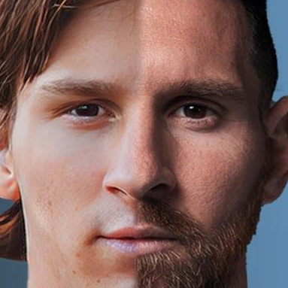
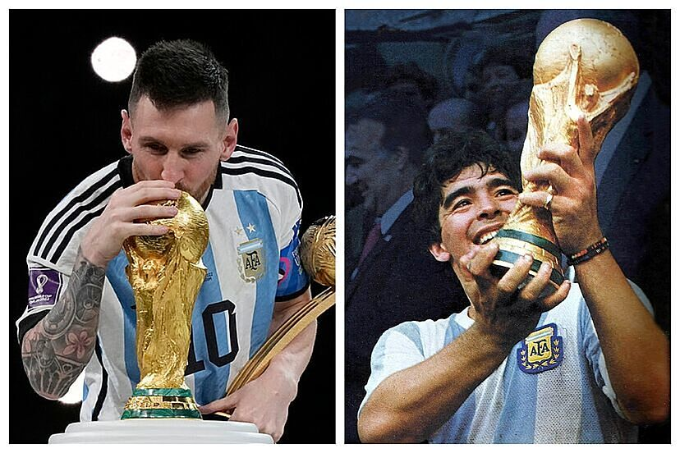
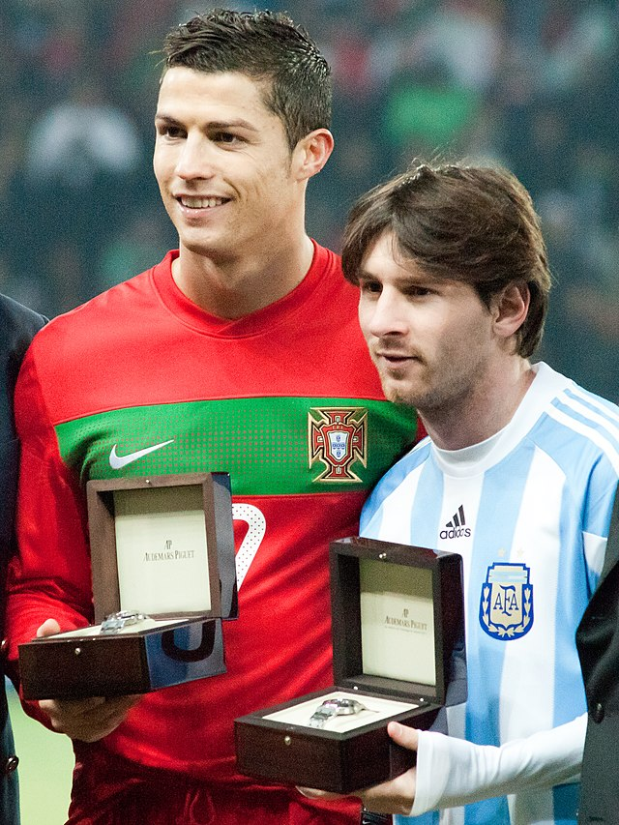
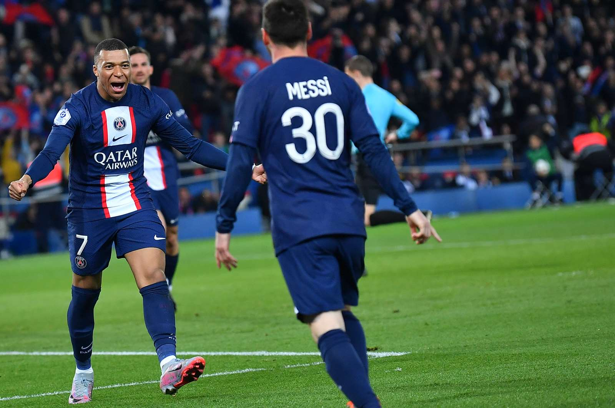
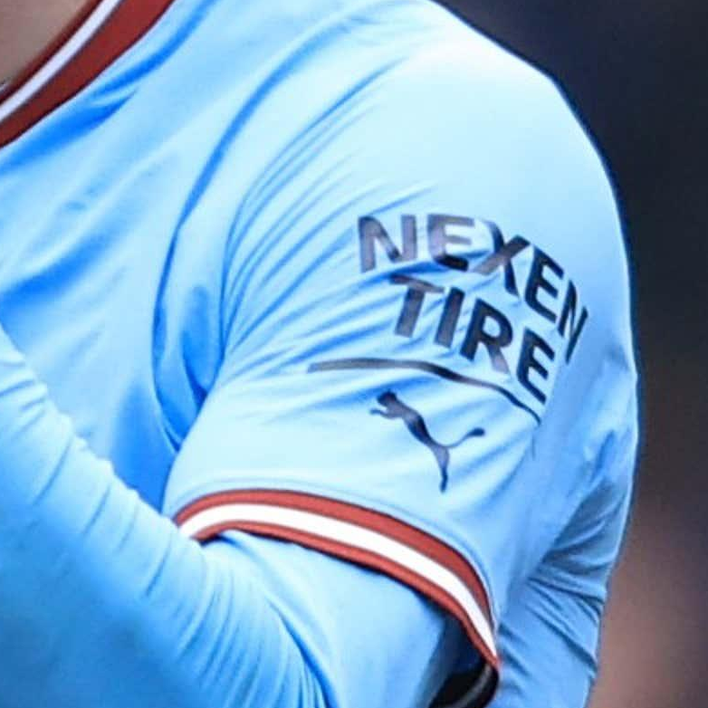
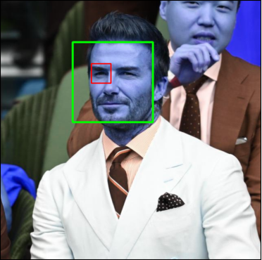
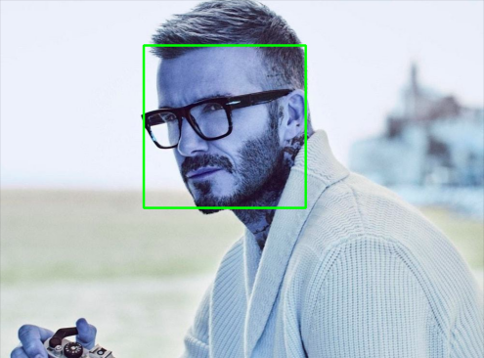
Some error
Data Preprocessing
Crawling error(Google image):
Cropping error(haarcascade model):

Slide 8
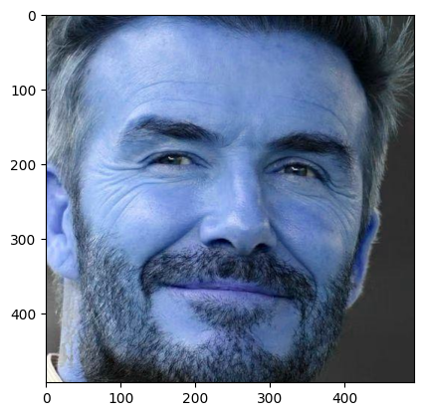
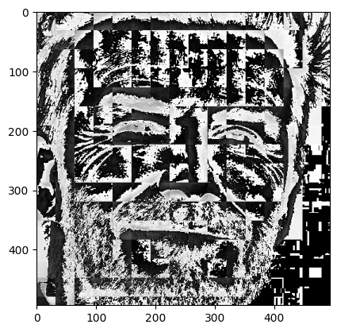
Wavelet transform(detail: report)
Data Preprocessing
Use wavelet transform as a feature for training our model, we use 1 image of this and 3 raw image stack for training.
In wavelet transformed image, you can see edges clearly and that can give us clues on various facial features such as eyes, nose, lips.

Slide 9
Model
We utilize 3 different basic ML models

Slide 10
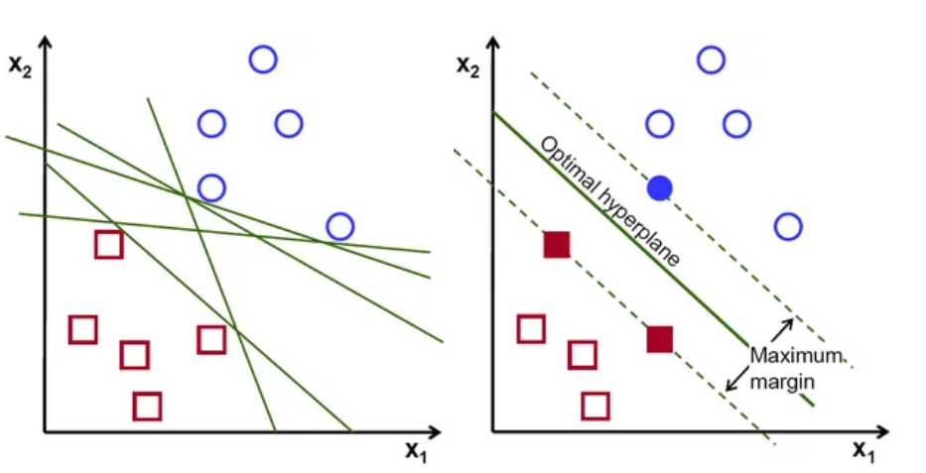
SVM Model
The objective of the support vector machine algorithm is to find a hyperplane in an N-dimensional space(N — the number of features) that distinctly classifies the data points.

Slide 11
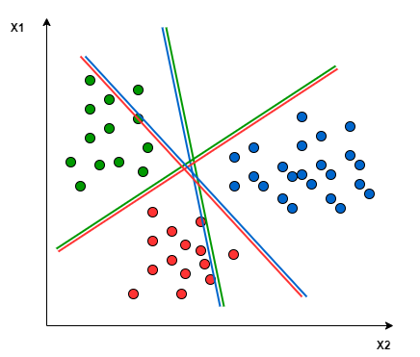
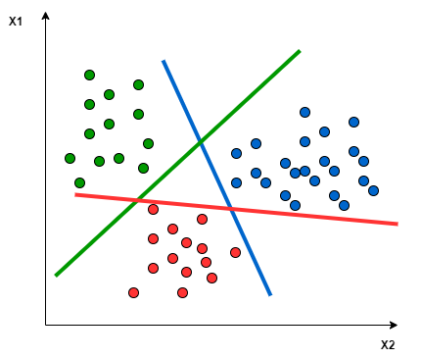
Multiclass Classification using SVM
SVM Model
In its most simple type, SVM doesn’t support multiclass classification natively. It supports binary classification and separating data points into two classes. For multiclass classification, the same principle is utilized after breaking down the multiclassification problem into multiple binary classification problems. There are 2 basic ways to approach:
One-to-one One-to-Rest

Slide 12
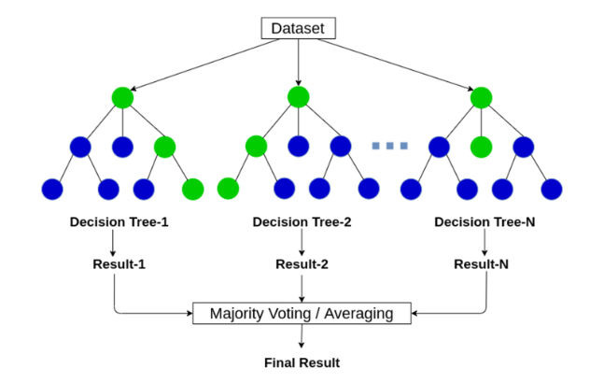
Random Forest Model
A Random Forest is an ensemble learning method belongs to the family of tree-based models and is particularly powerful and versatile, based on Decision Tree with random function

Slide 13
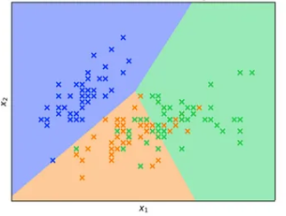
Logistic Regression Model
The same problem with SVM, these kind of algorithms design for binary classification problem though cannot use directly with multiclass classification problem but it still have great performance.
Heuristic methods can be used to split a multi-class classification problem into multiple binary classification datasets and train a binary classification model each. Two example is One-vs-Rest and One-vs-One

Slide 14
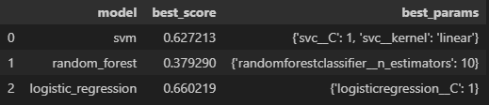
Fine-Tuning Hyperparameter
I use grid search with some most basic parameter that could make model better then save the best parameter for each model
Compare between 3 models with their best para
Quite good compare to 0.54 before tuning parameter

Slide 15
Experiment Results

Slide 16
Experiment Results
Before give data to model, we have already split train and test dataset 80%, 20%. Now we use test data for testing with model have best parameter
Support Vector Machine | Random Forest | Logistic Regression
0.6372549019607843 | 0.3235294117647059 | 0.7254901960784313

Slide 17
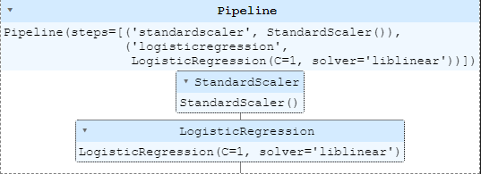
Experiment Results
Final Model
Next, we draw confusion matrix to see more clearly how well is our model

Slide 18
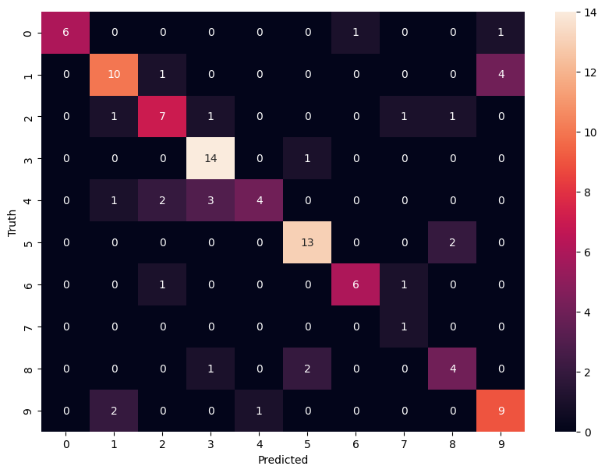
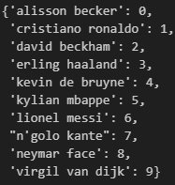
Experiment Results
Confusion matrix with label
We can see clearly our model do quite well with some footballers while other is not, this may because of the data collecting not so precisely

Slide 19
Conclusion and improvement
Although our basic ML model do quite well, we can use
stronger ML model like XGB or DL model.
We can apply data augmentation or maybe take more data from google like 1000 for each classes, take more mean clean and check more.
Use other model in preprocessing step, though very appreciate to haarcascade to one of the first model in detecting part of human body. Now it do not quite good as expected, we can try another model to detect face and 2 eyes, take full advantages of data collected.

Slide 20
DEMO
We save our model with label and put into server built port 5000 using flask library
Then we built UI run on that server, we will put it in local sever only

Slide 21


